Slide 1

Project 2: Online Retail
Elvessa Tatum
UHID: 2064084
Clustering Analysis

Slide 2
Background info
InvoiceNo | ID | Categorical | a 6-digit integral number uniquely assigned to each transaction. If this code starts with letter 'c', it indicates a cancellation |  | no
StockCode | ID | Categorical | a 5-digit integral number uniquely assigned to each distinct product |  | no
Description | Feature | Categorical | product name |  | no
Quantity | Feature | Integer | the quantities of each product (item) per transaction |  | no
InvoiceDate | Feature | Date | the day and time when each transaction was generated |  | no
UnitPrice | Feature | Continuous | product price per unit | sterling | no
CustomerID | Feature | Categorical | a 5-digit integral number uniquely assigned to each customer |  | no
Country | Feature | Categorical | the name of the country where each customer resides |  | no
Today, I plan on using the UCI online retail dataset to group customers by their spending behavior. This dataset has a list of transactions between 01/12/2010 and 09/12/2011 for a UK-based and registered non-store online retail. This is important to see certain aspects of online shopping, such as people who return items, how much they spend, etc etc..
This dataset was chosen due to the small number of features that make it easy to focus on, along with the high amount of recorded observations. The 6 features are listed to the side.

Slide 3
Background info continued
K means clustering assigns records to each cluster to find the mutually exclusive cluster of spherical shape based on distance. It does this by using a pre-specified number of clusters.
Hierarchical clustering is a set of nested clusters that are arranged as a tree. It can use any number of clusters, and have divisive or agglomerative methods. Agglomerative methods begin with ‘n’ clusters and sequentially combine similar clusters until only one cluster is obtained. Divisive methods work in the opposite direction, beginning with one cluster that includes all the records.
Some advantages of K means clustering are that convergence is guaranteed, and it is specialized to clusters of different sizes and shapes. Some disadvantages of it are that K-Values are difficult to predict and it doesn't work well with global cluster.
One advantage of hierarchical clustering are the ease of handling of any forms of similarity or distance. Consequently, another advantage is the applicability to any type of attribute. A big disadvantage of hierarchical clustering is that it requires the computation and storage of an n×n distance matrix. For very large datasets, this can be expensive, and make the model very slow.
Hierarchical clustering is non-parametric. It doesn't assume a specific number of clusters or a specific shape of the clusters. It is flexible and can adapt to various types of cluster shapes.
K means is parametric. It assumes that the data forms clusters that are spherical and uses the Euclidean distance to form the clusters. It requires you to predefine the number of clusters (k), which makes it a parametric model.
We’ll be using K means clustering and hierarchical clustering on the dataset, as we can estimate the right amount of clusters needed for both algorithms (K means through elbow method and hierarchical through the dendrogram.

Slide 4
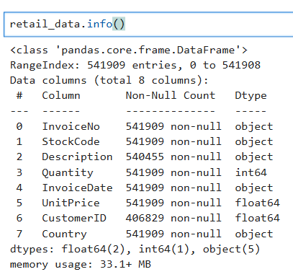
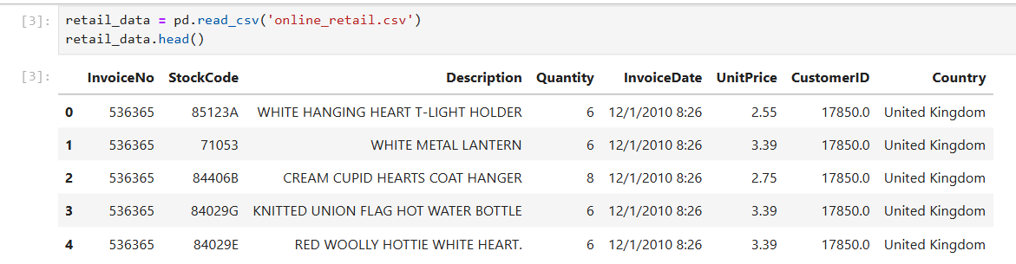
Importing data
Let’s import the data and see what we have

Slide 5
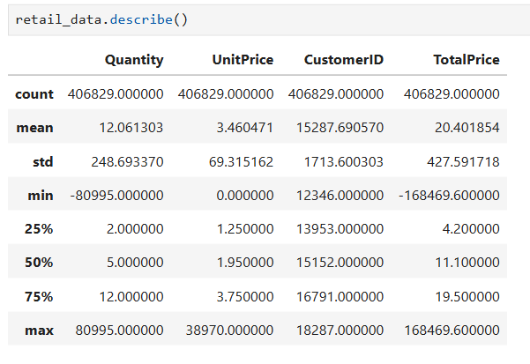
Importing data continued
Let’s use describe

Slide 6
Importing data continued
From here, we can see that the categorical variables are: InvoiceNo, StockCode, Country, Description, InvoiceDate, and customerID.
On the other hand, the numerical values are quantity, UnitPrice, and customerID.
CustomerID is listed as categorical on the dataset website, but numerical in the actual dataset. We will count it as “both” here.

Slide 7
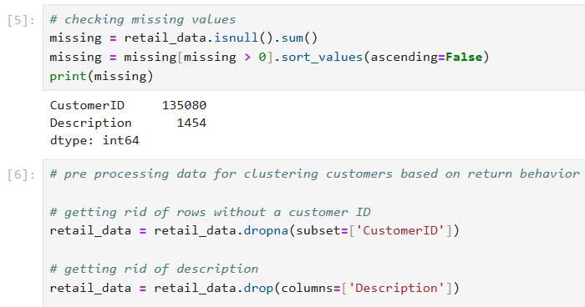
Importing Data continued
Let’s check for missing values and handle them. We’ll also get rid of description, since it isn’t important.

Slide 8
Pre processing data
Let’s add a variable. We’ll add a variable called “IsReturn,” which labels if a customer returned or canceled an item.
We’ll also start to add more features based on customer behavior.

Slide 9
Pre-Processing data continued
Let’s break this down. The “TotalPrice” variable is used to see how much money was involved in each transaction
We then make a variable named “customer_returns,” which is a variable that holds information on the spending behavior on each customer. For this, we calculate the following:
TotalTransactions: Number of unique invoices (how many separate purchases they made).
TotalItems: Total quantity of items bought (net of purchases and returns).
TotalReturns: How many of those transactions were returns.
TotalQuantityReturned: Sum of quantities that were returned (only negative quantities).
TotalMoneySpent: Sum of total prices where the transaction was positive (they actually bought something).
TotalMoneyReturned: Sum of total prices where the transaction was negative (they returned something).
Finally, we calculate ReturnRate and NetSpending. ReturnRate denotes what proportion of a customers purchases involved returns. Meanwhile, NetSpending represents true spending after accounting for refunds.

Slide 10
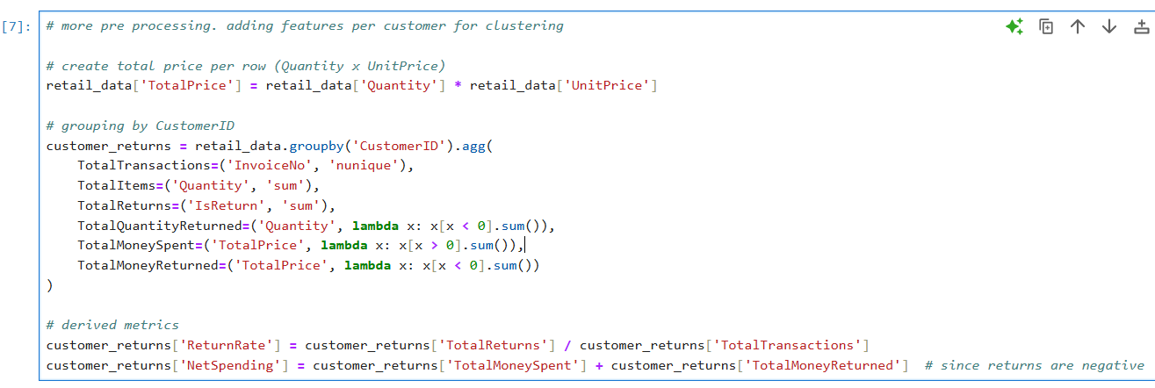
Pre-Processing data continued

Slide 11
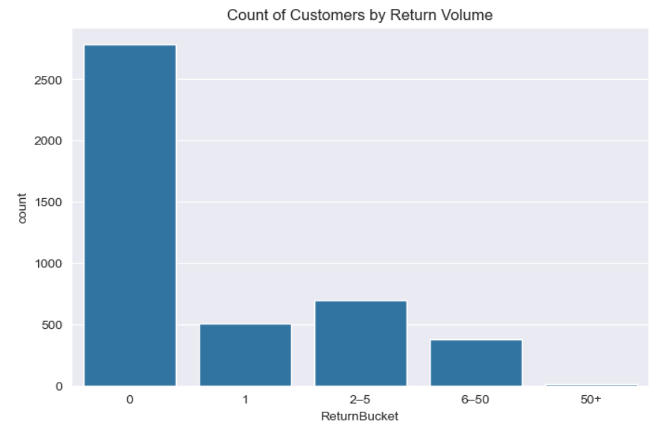
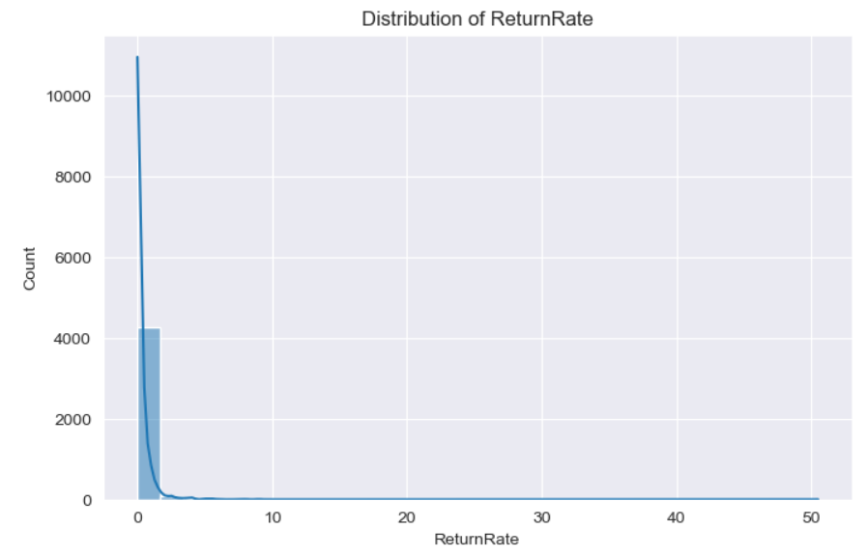
Data Exploration and visualization
Now that we have our new variables to account for customer behavior, let’s look at some graphs surrounding them. Here is a distribution of ReturnRate, and a overall count of customers by return volume
From here, we can see that the amount of people who return things isn’t very high. Most customers haven’t returned any items. Those who have, haven’t returned that many.

Slide 12
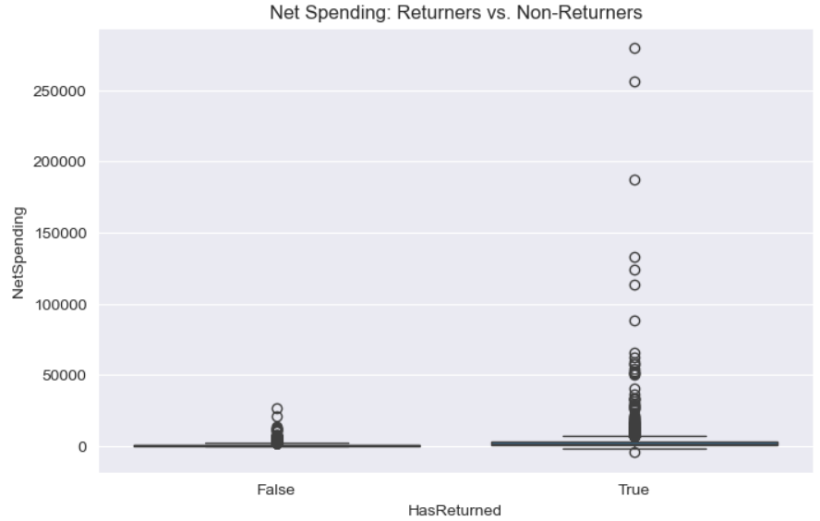
Data exploration and visualization continued
Now, let’s look at the NetSpending of people who returned items vs didn’t return items
Clearly, people who have returned items spend muchmore money than those who haven’t

Slide 13
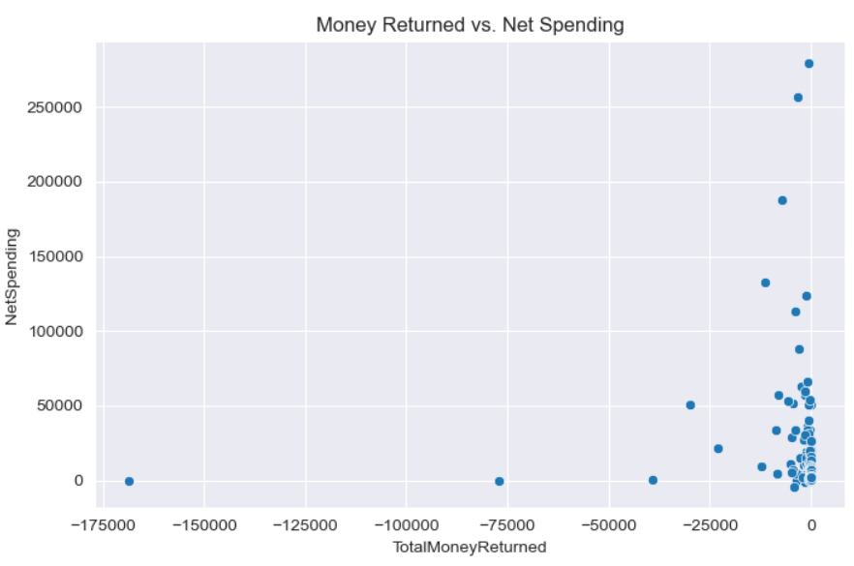
Data exploration and visualization continued
Next, let’s look at a graph of the money returned vs net spending.
Outside of some outliers, it is clear that people didn’t receive much money back, but did spent a lot of money. This lines up with the idea that not many returns were done. Since there weren’t many returns, people didn’t get much money back.

Slide 14
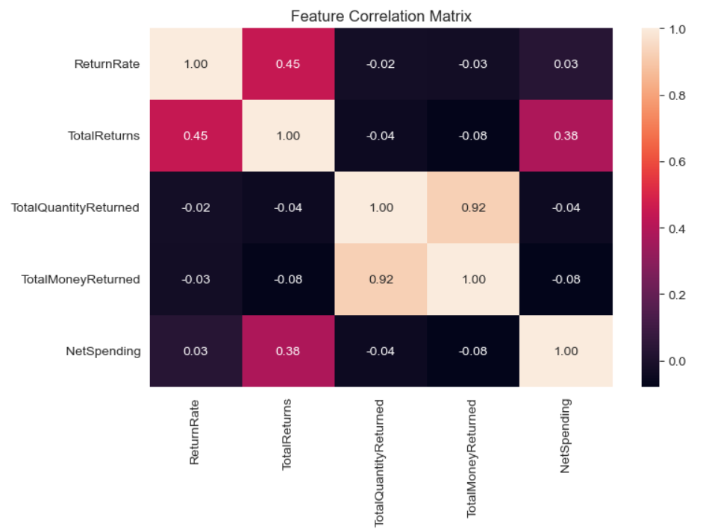
Data exploration and visualization continued
Finally, let’s look at a heatmap of our new variables.
From this, we can see that the total money returned is highly correlated with the total quantity returned. Some other variables that are correlated well with each other are net spending and total returns, and total returns and return rate.

Slide 15
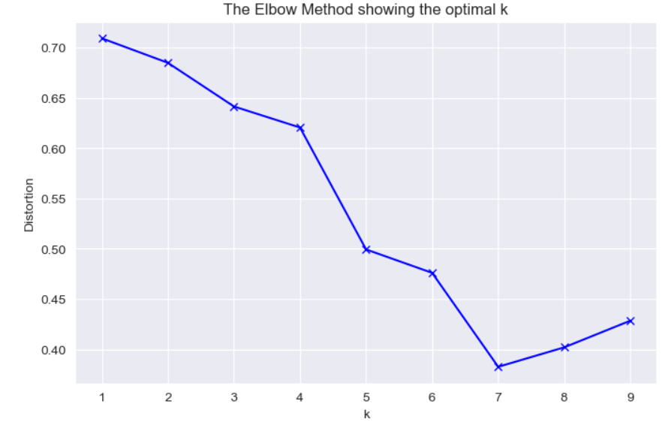
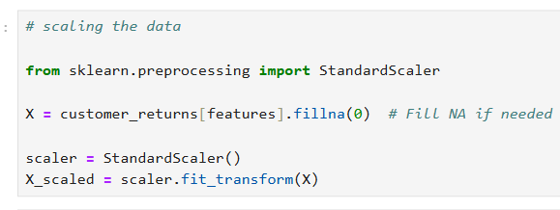
Scaling and initial model creation
Let’s use the standard scaler, as scaling the data will help balance it. Thus, our model will be more accurate.
We’ll start with K means, finding the optimal k with the elbow method.
The optimal K seems to be around 7, so we’ll use that for our model

Slide 16
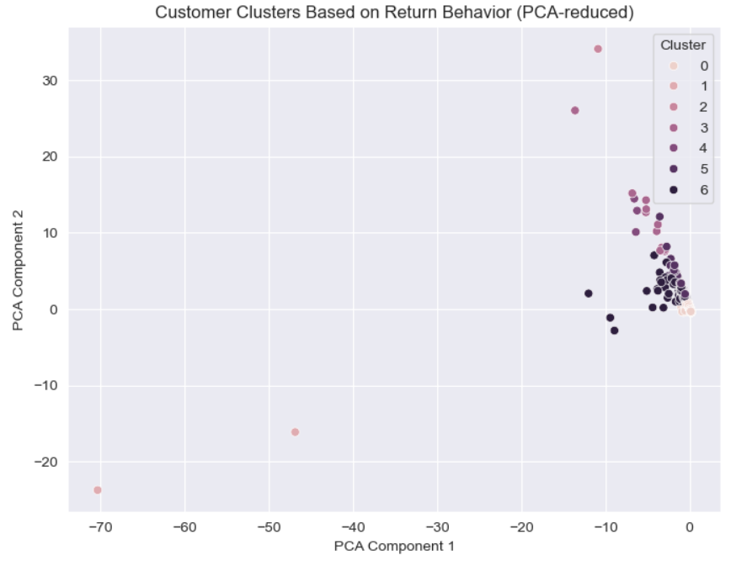
Initial model creation
We will now use PCA to make the model good for plotting, then plot the K means model
As we can see, our model is heavily skewed. Let’s normalize it then try again.

Slide 17
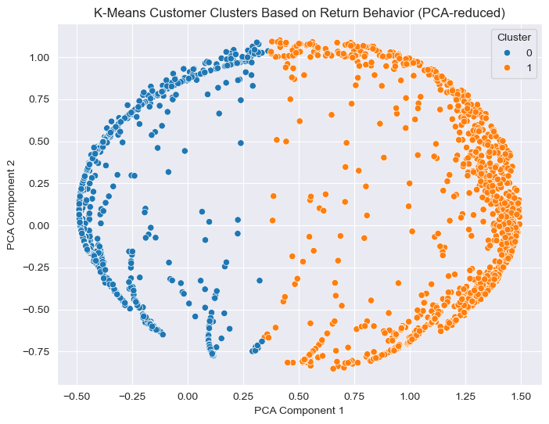
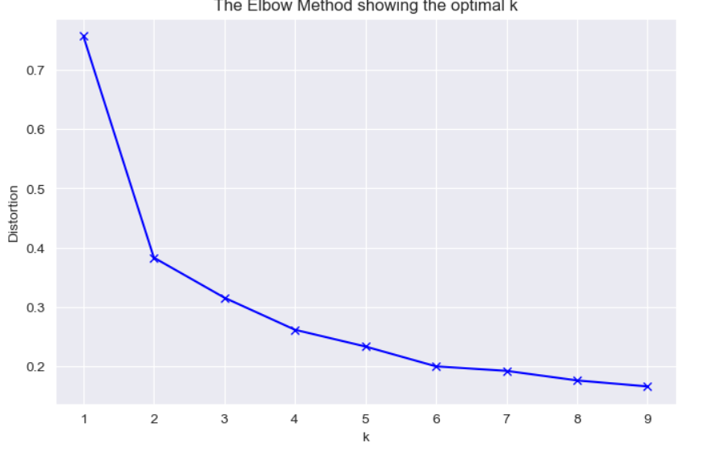
Model creation continued
After normalizing, the optimal K seems to be 2. let’s run the model again with this in mind.
Now we have a better model visually, and the silhouette score for this model is 0.68, which is very good
This model shows a clear distinction of the 2 clusters based on the customer’s spending habits

Slide 18
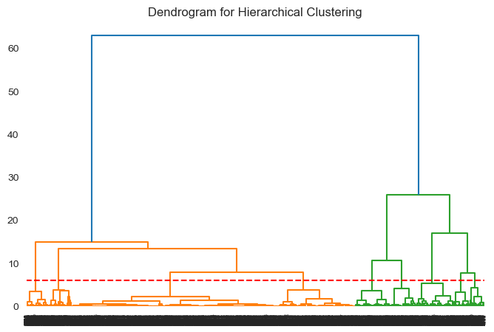
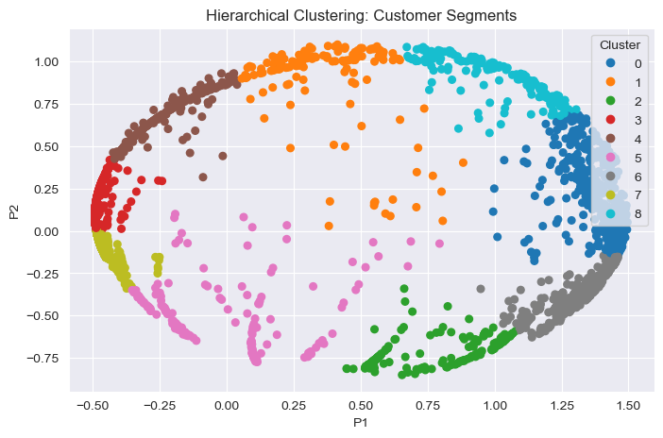
Model creation continued
Now, let’s use hierarchical clustering. First we’ll use a dendrogram to find the right number of clusters then run it.
The right number of clusters seems to be 9.
The silhouette score is 0.58. Definitely worse than the K means model, but does show the clusters better than before without the normalizing

Slide 19
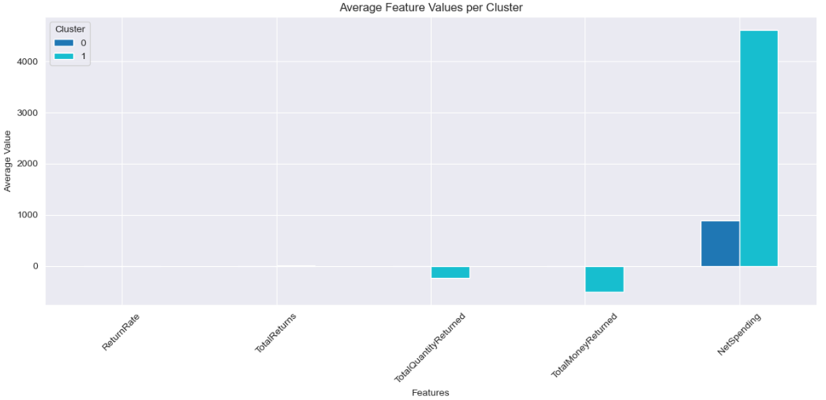
Model creation continued
Finally, let’s look at the average values of key return-related features for each customer cluster.
From here, we can tell that Cluster 1 customers spend much more on average than Cluster 0. This indicates that Cluster 1 likely includes high-value customers.
Cluster 1 has higher negative values for TotalMoneyReturned and TotalQuantityReturned, meaning they return more items and return higher-value products. Despite that, their high NetSpending suggests they still generate significant revenue.
Both clusters have relatively low ReturnRates and TotalReturns on average. Differences here are minor compared to NetSpending.
From this, we can tell that Cluster 0 represents lower-spending, lower-returning customers (possibly occasional or new buyers). Meanwhile, Cluster 1 represents high-spending, high-returning customers (possibly loyal or bulk buyers with more complex purchasing behavior).

Slide 20
Conclusion
Clearly, the K means model did far better than the hierarchical clustering model. This can be seen by the K means model having a silhouette score over 0.1 higher than the hierarchical clustering model. Normalizing the data also helped make the models work far better than just scaling them.
We have seen that despite there being a multitude of spending behaviors in the clusters, a majority of customers don’t return items. Even if they do, those who do spend far more money than those who do not. Thus, businesses shouldn’t worry too much about people returning items. If anything, it may be a good thing for them, since those customers will spend more money on the business anyways.
If I was to do this again in the future, I’d use different scalers to see if they work better with the data.

